Slide 1
Lung image analysis
YANG, Liu

Slide 2
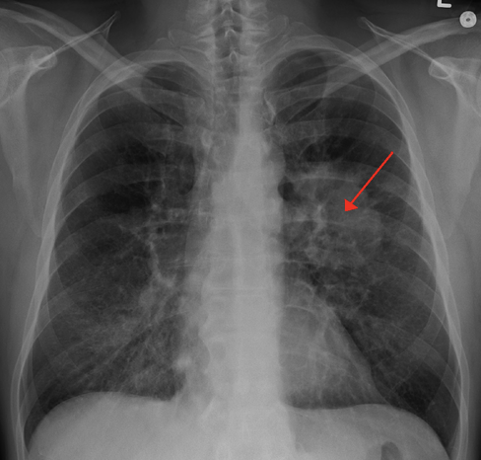
BACKGROUND
Lung cancer, also known as lung carcinoma, is a malignant lung tumor characterized by uncontrolled cell growth in tissues of the lung.
Worldwide in 2012, lung cancer occurred in 1.8 million people and resulted in 1.6 million deaths.
This makes it the most common cause of cancer-related death in men and second most common in women after breast cancer.
However, only 15% of diagnosed lung cancers are at this early stage.
The survival rate for the cancer patient can be increased by detecting the occurrence of cancer in earlier stages.

Slide 3
BRIEF INTRODUCTION
The field of computer-aided or computer-assisted diagnosis (CAD) encompasses an immense number of potential applications, both medical and non-medical. Computer-aided diagnosis is best defined as a method of assisting radiologic interpretation by means of computer image analysis. Ideally, CAD results in improved decision-making and performance due to enhanced detection and evaluation of complex imaging features, decreased inter observer variability, and elimination of otherwise repetitive or tedious tasks.
In this project, I will try to detect lung cancer from the analysis of CT images of chest. My system can be able to detect the false positive nodules accurately.

Slide 4
main workflow
Lung Regions Extraction
Segmentation of Lung Region
Analysis of Segmented Lung Region
Training of Model
Testing and Evaluation

Slide 5
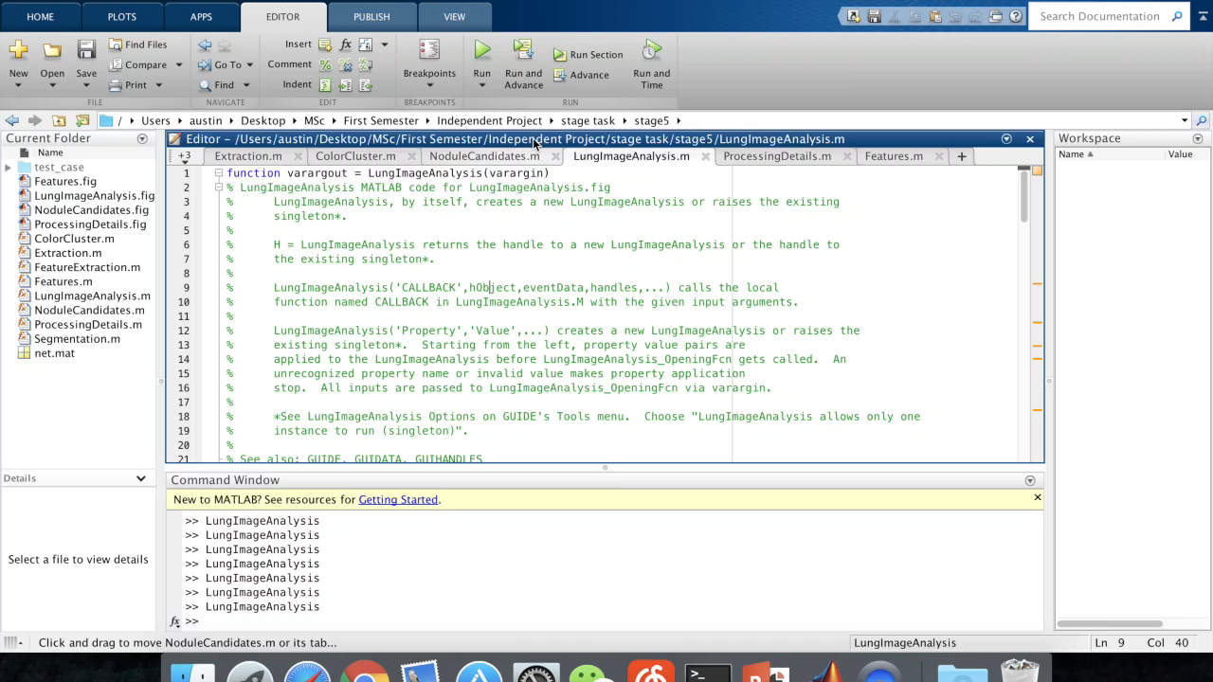
Let’s watch a video

Slide 6
Technical details

Slide 7
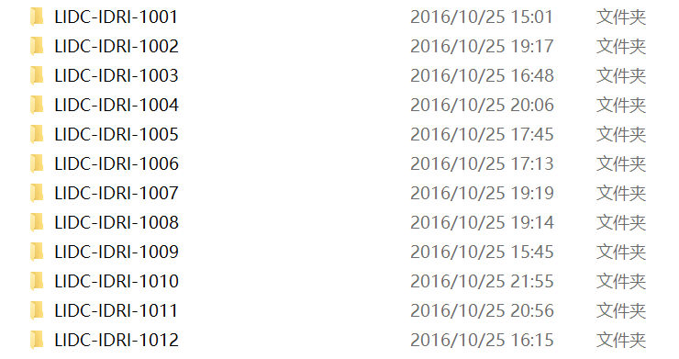
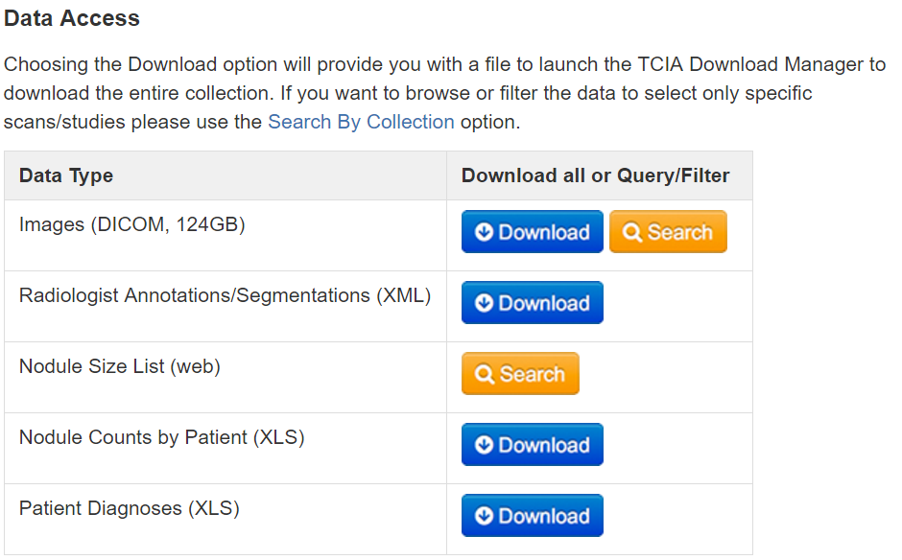
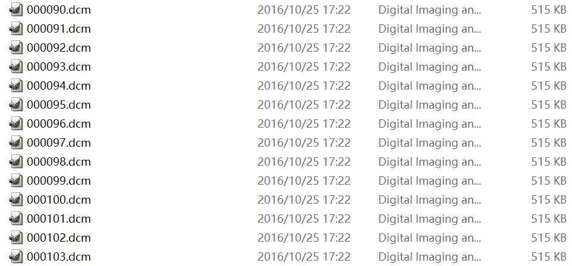
step 0 preprocessing database
Lung Image Database Consortium(LIDC)
This database consists of diagnostic and lung cancer screening thoracic computed tomography (CT) scans with marked-up annotated lesions.
This database contains about 1000 patients.
Every patient contains about 300 CT images.
Totally about 300,000 CT images and 124G storage.

Slide 8
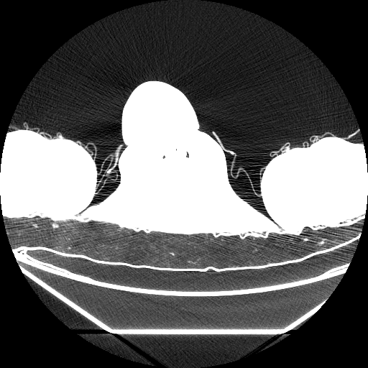
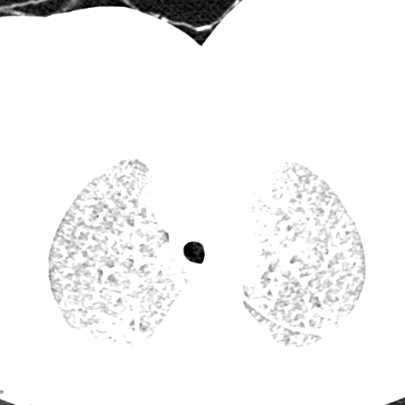
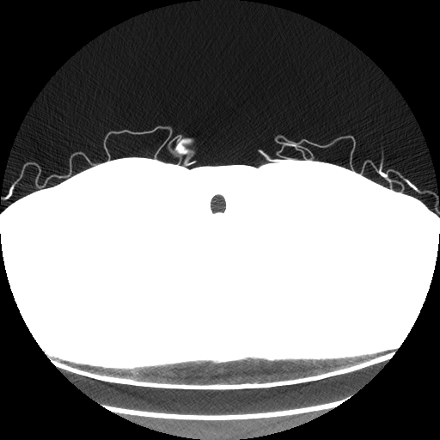
step 0 preprocessing database
Not all CT images are useful.
I want images like this:
Dislike these kinds of images:

Slide 9
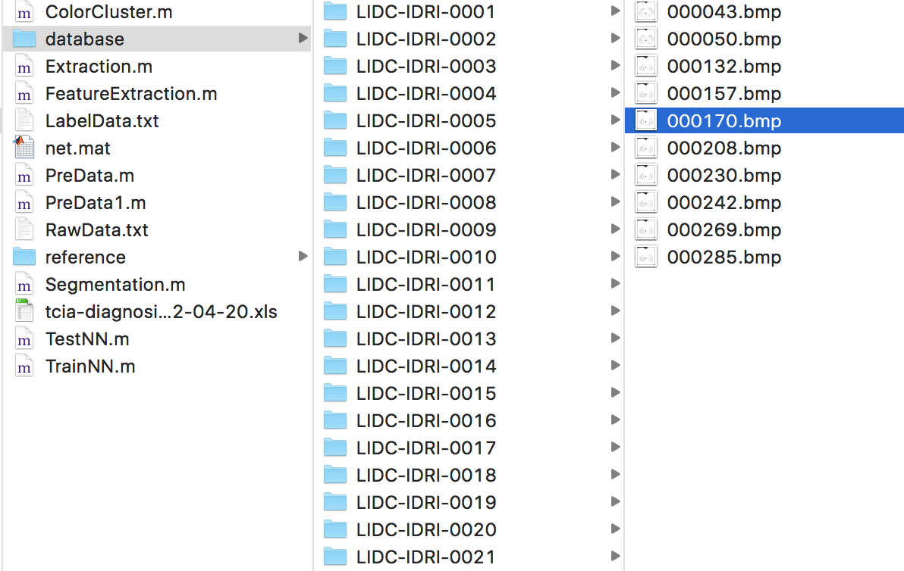
step 0 preprocessing database
Using scripts to eliminate worse images and retain the clear ones.
Getting a smaller and suitable database.
The new database contains about 800 patients.
Every patient contains 10 CT images.

Slide 10
step 1 Lung Region Extraction
Detecting the lung region and regions of interest(ROIs)
Original Image
Median Filter
Bit-Plane Slicing
Erosion
Lung Border Extraction
Outlining
Dilation
Extracted Lung
Flood Fill Algorithm

Slide 11
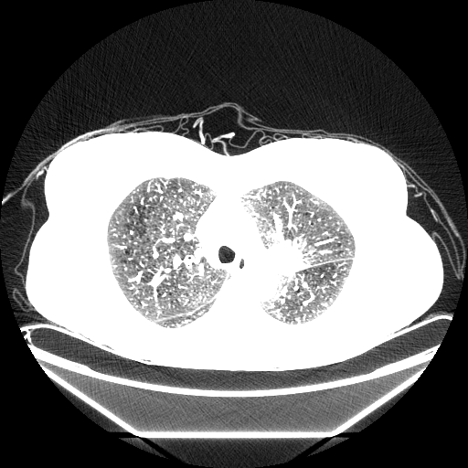



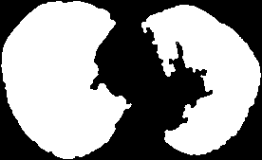
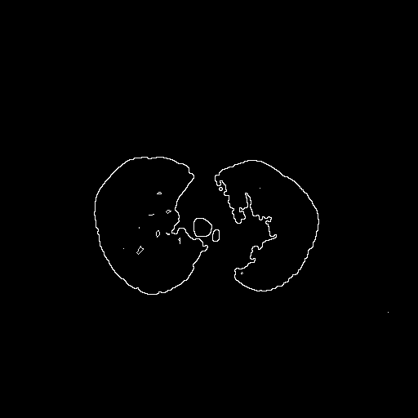
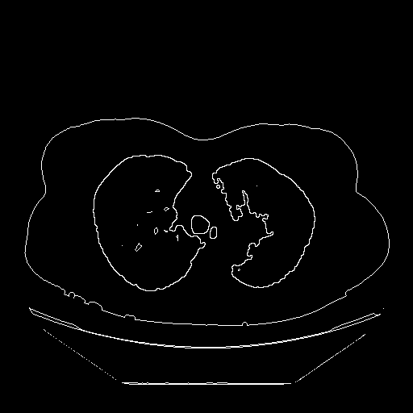

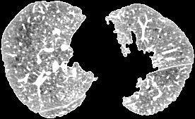
step 1 Lung Region Extraction

Slide 12
step 2 Lung Regions Segmentation
Identifying the region of interest(ROIs) which helps in determining the cancer region.
Using K-Means(K=8) to do the clustering.
Getting 8 candidates of lung nodule.

Slide 13
step 3 Features Extraction
Extracting three kinds of features from a CT image:
Area of the candidate region
The Maximum Drawable Circle (MDC) inside the candidate region
Mean intensity value of the candidate region
Getting a 3x8 matrix(3 features * 8 nodule candidates).
Taking an average of 8 candidates and getting a 3x1 matrix to represent this CT image.

Slide 14
step 4 Model Training
Using the labeled features to train our model – a Neural Network with 10 neutrons and three layers.

Slide 15
step 4 Model Training

Slide 16
step 5 Testing
Using additional labeled data to test.
Accuracy: 0.8381

Slide 17
Thank you!
Every step of life will not waste.
人生沒有白走的路，每一步都算數。

